Slide 1
Better Food Choices for Health:
The Role of Product Appeal and Perception in Breakfast Cereal Choices
Jutta Roosenª
joint with Herdis Agovi^{b}, Christina Neubigª, Matthias Staudigelª
The Batsheva de Rothschild Workshop on "Avoiding the coming food security crisis: Novel solutions at the intersection of agriculture, environment and health”
The Hebrew University of Jerusalem, November 9-10, 2022
ª Technical University of Munich ^{b} University of Florence

Slide 2
Introduction (1)
Innovation-driven productivity gains are required to assure food security in the face of various challenges putting production systems and ecosystems under stress
Productivity gains don’t only have to respect the need for more calories, but also “better” calories
Nutrient density and dietary quality are key aspects to fight malnutrition in all its forms (undernutrition, overnutrition, and micronutrient deficiencies)

Slide 3
Introduction (2)
Unbalanced nutrient intakes and unhealthy diets as key risk factors for cardiovascular diseases, some cancers, and type-II-diabetes.
Major contributor to the rapid global rise in overweight and obesity
WHO estimates for 2016:
650 million obese adults
>340 million overweight or obese children and adolescents (5-19 y)
Important role of food value chains:
Provision of information enabling healthy and sustainable food choices
Reformulation of processed foods by reducing their fat, sugar, or salt content
Enabling the production of raw materials for healthy nutrition
  nutrient-rich content
  types of food
Source: WHO (2020)

Slide 4


Introduction: The role of food processing (3)
Protein
Calcium
Vitamin B2
Vitamin B12
Phosphorus
Iodine

Slide 5
Variation in sugar [g/100g] in children cereals
Staudigel, M., M. Oehlmann, J. Roosen (2022) based on GfK panel for product selection and product search via internet and Mintel GNDP for nutrient content.

Slide 6
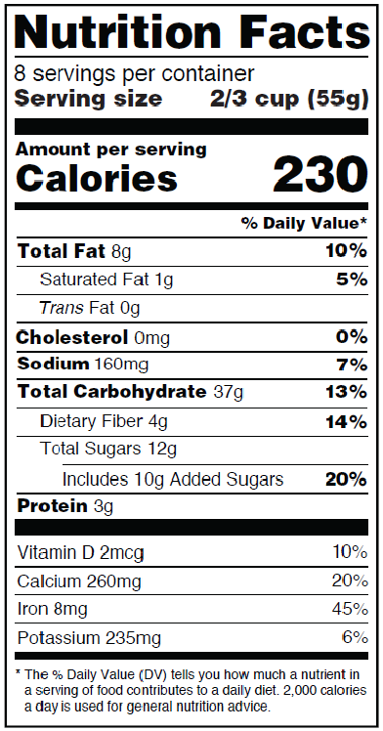

Approaches to product design and reformulations
estimation of nutrient elasticities
vs.
understanding of product appeal and consumer perception
Staudigel and Anders (2020). Effects of the FDA’s sodium reduction strategy in the U.S. market for chip products. J Econ Beh and Org 173: 216-238.
Romagny, S., Ginon, E., Salles, C., 2017. Impact of reducing fat, salt and sugar in commercial foods on consumer acceptability and willingness to pay in real tasting conditions: A home experiment. Food Qual. Prefer. 56, 164–172.

Slide 7
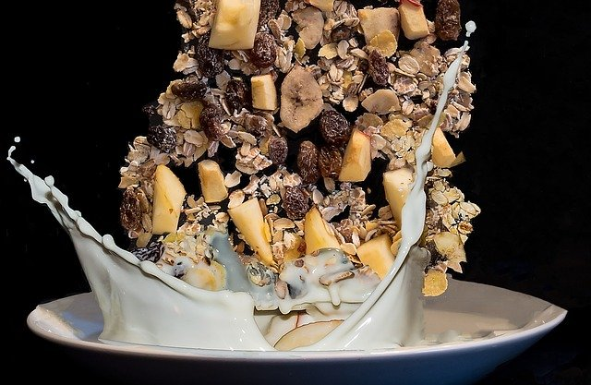
Challenges
High degree of horizontal product differentiation
Unclear which attributes to take into account
Cue attributes (Caputo, Scarpa, Nayga, 2017) may signal various meanings to consumers

Slide 8
This Study - Objectives
Measure product perceptions and taste expectations by consumers to better describe food choice options
Understand the role of heterogeneity in perception and evaluation processes

Slide 9
Methodological approach (1)
Understand how taste expectations drive food product choice and how this is related to attribute levels
extrinsic attributes
taste expectations
+
hedonic liking
product choice
intrinsic attributes
Focus on mueslis: For the large share of chocolate mueslis in the German market for breakfast cereals.
Notes:
national reduction and innovation strategy by German government, formulated in 2018.

Slide 10
Methodological approach (2)
Understand how taste expectations drive food product choice and how this is related to attribute levels
extrinsic attributes
taste expectations
+
hedonic liking
product choice
intrinsic attributes
market search based on GfK
household scanner data
24 products in three types & 6 brands with various nutrient claims (e.g., no added sugar etc.)

Slide 11
Methodological approach (3)
Understand how taste expectations drive food product choice and how this is related to attribute levels
extrinsic attributes
taste expectations
+
hedonic liking
product choice
intrinsic attributes
CATA measure of sensory repertoire
9-point hedonic liking score in online survey
in 2 groups à 12 products (n=179, 171)
development of repertoire of sensory descriptors (sour, sweet, …)

Slide 12
Methodological approach (4)
Understand how taste expectations drive food product choice and how this is related to attribute levels
extrinsic attributes
taste expectations
+
hedonic liking
product choice
intrinsic attributes
DCE with 24 mueslis in 72 choice sets (3 blocks) of binary forced choice
in online survey with 350 consumers

Slide 13
The Muesli Market in Germany
565 unique product identifiers (EAN)
66 brands/sub-brands
2 main national brands
4 main retail brands
exclusion of specialty mueslis and organic mueslis due to segregated market
Source: Gfk, 2017

Slide 14

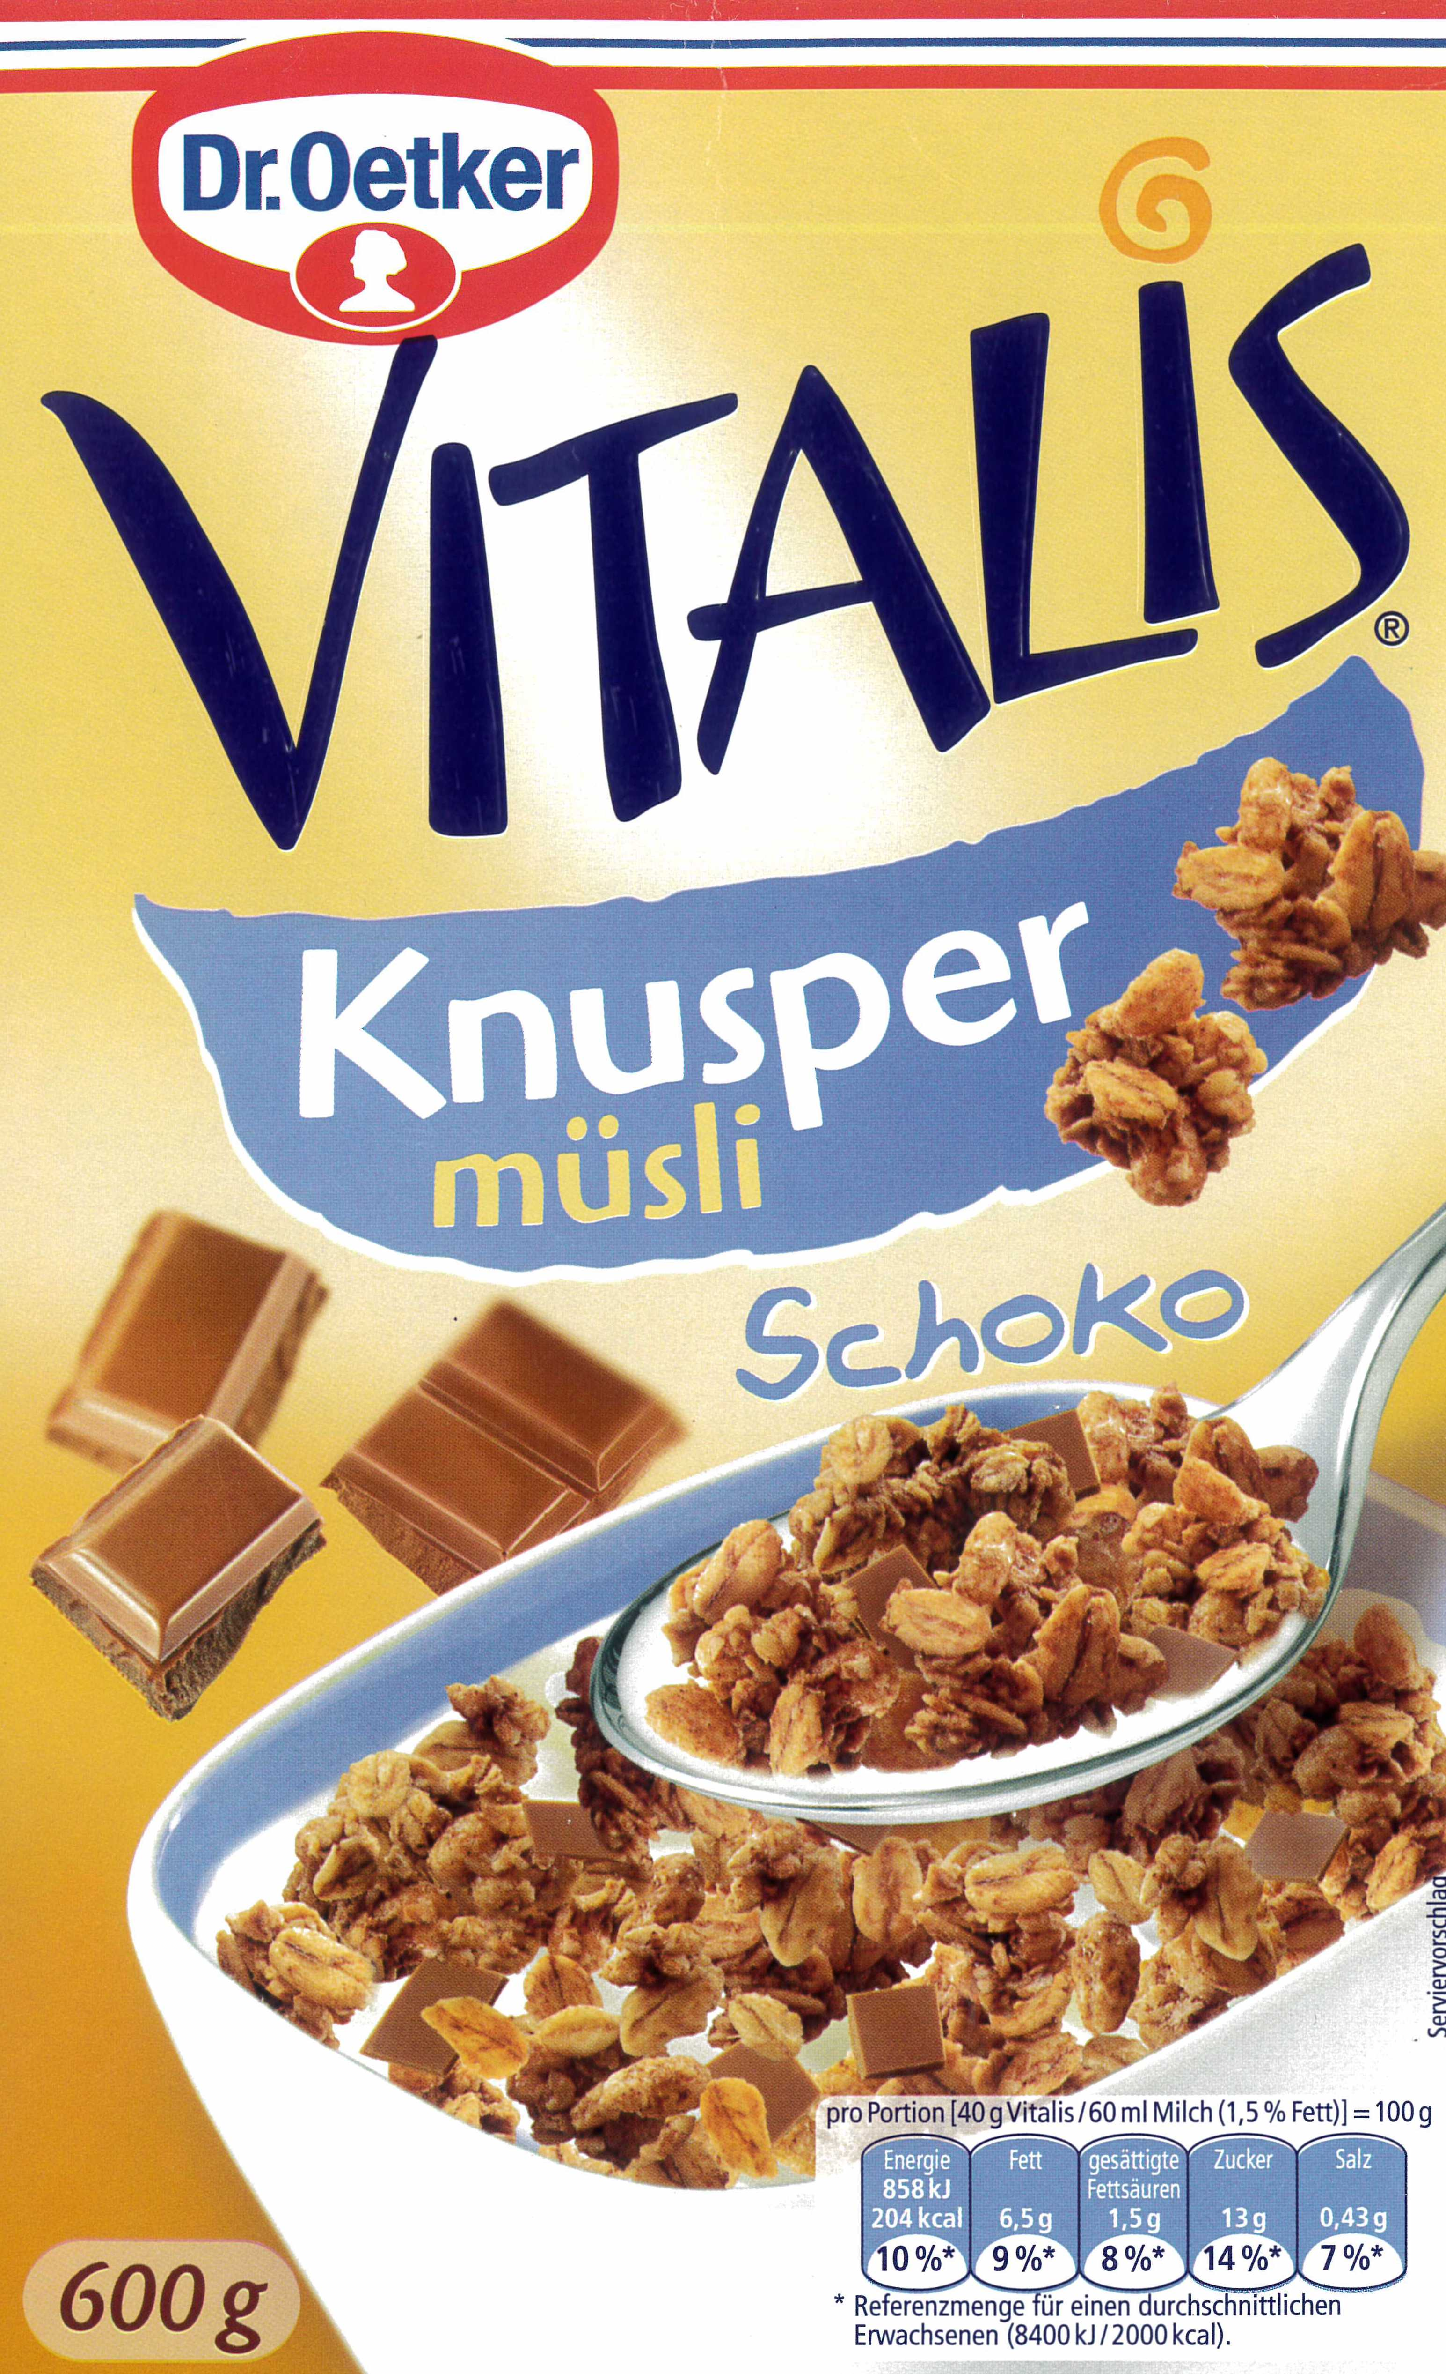
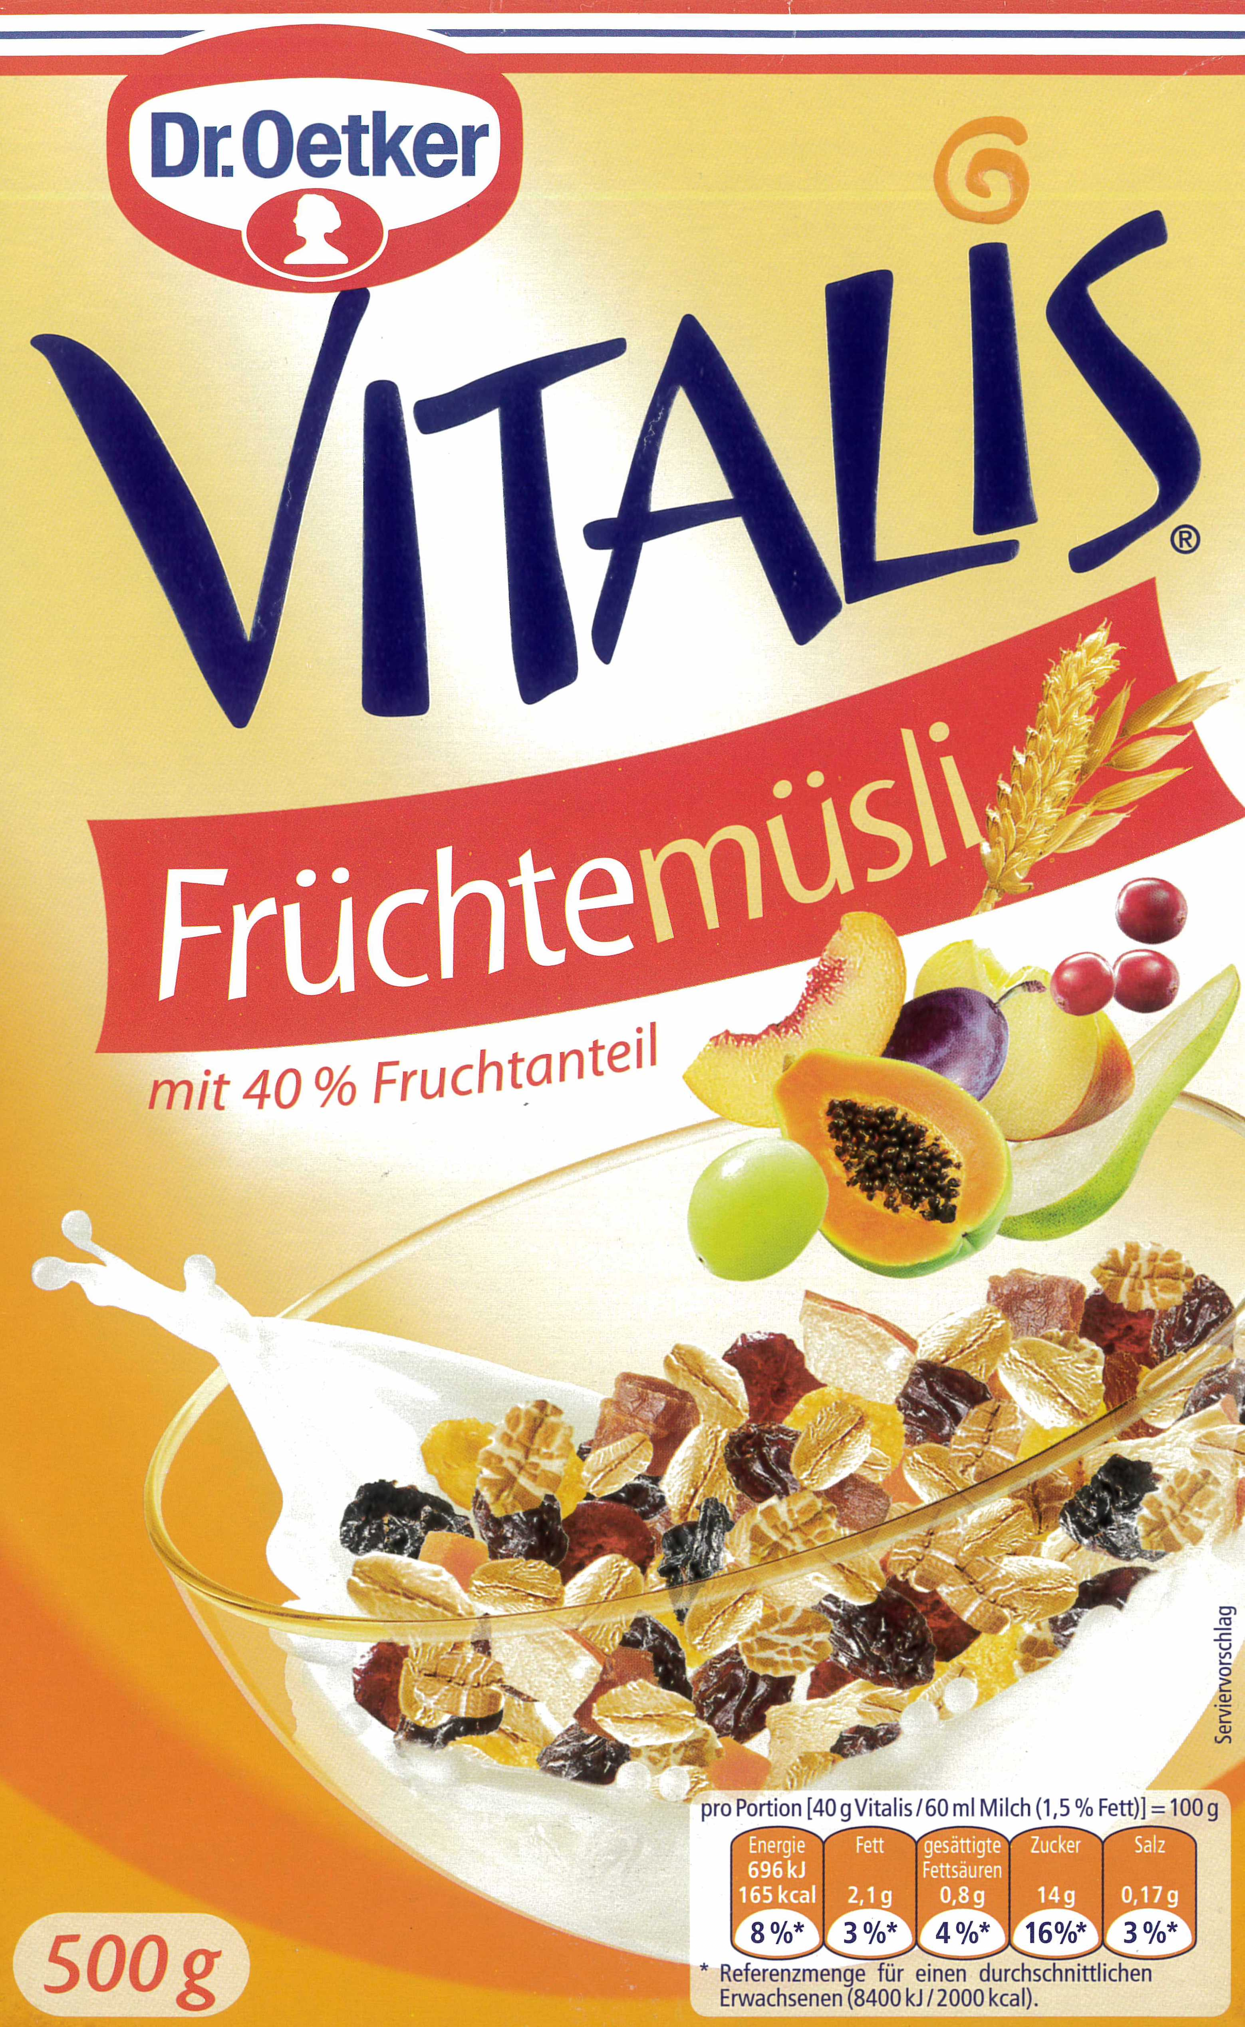
Methods – Sensory repertoire
develop repertory of suitable descriptors
2 focus groups online with 6 consumers each
3 cereals of market leader (chocolate, crunchy, fruit)
tasting with milk or similar
description with adjectives

Slide 15
Results sensory repertoire
In focus group 1/2
22 /24 for chocolate
9/22 for crunchy
21/25 descriptors for fruit mueslis
translated using ISO norms or Oxford Shorter Dictionary
reduction in multiple assessment rounds to assure sufficient relevance and coverage for the three muesli types

Slide 16
Repertoire of sensory descriptors
bitter
sweet
crispy
sour
insipid
soft
chewy
cereal(ly)
coarse
acid
harmonious
intensive
All descriptors used in CATA evaluation of 12 products by each subject.
CATA = check-all-that-apply

Slide 17
Attribute description of mueslis and mean CATA value per muesli type (n = 179 and 171)
b
b
a
a
c
a
b
b
b
c
a
a
a
b
a
a
a
a
c
a
a
a
b
c
a
a
a
b
a
c
b
c
b
b
a
a
Graph shows relative share of participants who checked an item; a, b, c denote significant differences at p<0.05 linewise.

Slide 18
Choice experiment with 24 muesli products
24 product options were taken:
6 major brands (2 national brands & 4 private labels)
3 types per brand (chocolate, crunchy, fruit)
various subtypes (no added sugar, sugar reduced, dark chocolate, 40 % fruit etc.)

Slide 19
Survey set-up
CATA &
hedonic liking on
12 products
Attention
bias test
Choice experiments
among 24 products
CATA &
hedonic liking on
12 products
Dichotomous choice with 24 choice sets in three blocks
350 participants, 16,800 observations
Limit to choice sets with taste expectations (CATA &
hedonic) on both product options leading to 4,394 obs

Slide 20

Choice modelling
Binary forced choices are analyzed using multinomial logit model
Choice determinants are
  price
  type (base = fruit)
  brand (base = vitalis)
  labels (dummy)
  CATA (m-CATA)
Label
$$U_{njt}=α_{type,njt}+ α_{brand, njt}$$
$+β_{p} {price}_{njt}+ δ {label}_{njt}+ε_{njt}$
CATA
$$U_{njt}=α_{type,njt}+ α_{brand, njt}$$
$+β_{p} {price}_{njt}+λ {CATA}_{njt}+ε_{njt}$
with $ε_{njt}\sim IID EV$ type I

Slide 21
Multinomial logit estimation
Variablesª | label | mcata | mcata | cata | Variables
price | -0.410*** | -0.485*** | -0.818*** | -0.441*** | price
crunchy | 0.689*** | 1.151*** | 1.752*** | 0.631*** | crunchy
chocolate | 0.494*** | 0.916*** | 1.741*** | 0.341*** | chocolate
attributes | … | ... | ... | … | descriptors
brands | … | ... | ... | … | brands
Observations | 16,800 | 16,800 | 4,394 | 4,394 | Observations
Correct Prediction | 0.627 | 0.631 | 0.631 | 0.669 | Correct Prediction
using labels or mean cata allows
for including both subsamples
ª All models control for package weight.

Slide 22
Multinomial logit estimation
Variablesª | label | mcata-full | mcata-red | cata | Variables
price | -0.410*** | -0.485*** | -0.818*** | -0.441*** | price
crunchy | 0.689*** | 1.151*** | 1.752*** | 0.631*** | crunchy
chocolate | 0.494*** | 0.916*** | 1.741*** | 0.341*** | chocolate
attributes | … | ... | ... | … | descriptors
brands | … | ... | ... | … | brands
Observations | 16,800 | 16,800 | 4,394 | 4,394 | Observations
Correct Prediction | 0.627 | 0.631 | 0.631 | 0.669 | Correct Prediction
individual values reduce sample but improve depiction of heterogeneity
ª All models control for package weight.

Slide 23
Multinomial logit estimation
Variables | label | mcata-full | mcata-red | cata | Variables
price | -0.410*** | -0.485*** | -0.818*** | -0.441*** | price
crunchy | 0.689*** | 1.151*** | 1.752*** | 0.631*** | crunchy
chocolate | 0.494*** | 0.916*** | 1.741*** | 0.341*** | chocolate
attributes | … | … | ... | … | catas
Brands | … | … | ... | … | brands
Observations | 16,800 | 4,394 | 16,800 | 4,394 | Observations
Correct Prediction | 0.627 | 0.631 | 0.631 | 0.669 | Correct Prediction
The marginal utility of income is fairly stable across models.

Slide 24
Multinomial logit estimation
Variables | label | mcata-full | mcata-red | cata | Variables
dark | 0.099 | -5.919** | -.8.353 | -0.143** | bitter
less sweet | 0.580*** | -2.832*** | -8.397*** | 0.054 | sweet
without sugar | 0.051 | 0.174 | 0.109 | -0.330*** | crispy
whole grain | -0.344*** | -0.016 | -6.319* | -0.074 | sour
less fat | -0.195 | -2.744* | 6.400 | 0.214* | insipid
fruitpercent | -0.268** | 0.466 | -1.798 | -0.286*** | soft
 |  | 0.840 | 0.793 | 0.302** | chewy
 |  | 1.920 | 3.587 | 0.411*** | cereal(ly)
 |  | -0.601 | -2.894 | -0.239*** | coarse
 |  | 1.320 | 2.046 | 0.169 | acid
 |  | -0.543 | -8.682* | 0.443*** | harmonious
 |  | 2.871*** | 5.270 | 0.522*** | intensive
less sweet addresses specific segment
without added sugar is not appreciated

Slide 25
Multinomial logit estimation
Variables | label | mcata-full | mcata-red | cata | Variables
dark | 0.099 | -5.919** | -.8.353 | -0.143** | bitter
less sweet | 0.580*** | -2.832*** | -8.397*** | 0.054 | sweet
without sugar | 0.051 | 0.174 | 0.109 | -0.330*** | crispy
whole grain | -0.344*** | -0.016 | -6.319* | -0.074 | sour
less fat | -0.195 | -2.744* | 6.400 | 0.214* | insipid
fruitpercent | -0.268** | 0.466 | -1.798 | -0.286*** | soft
 |  | 0.840 | 0.793 | 0.302** | chewy
 |  | 1.920 | 3.587 | 0.411*** | cereal(ly)
 |  | -0.601 | -2.894 | -0.239*** | coarse
 |  | 1.320 | 2.046 | 0.169 | acid
 |  | -0.543 | -8.682* | 0.443*** | harmonious
 |  | 2.871*** | 5.270 | 0.522*** | intensive
Perceived as sweet and insipid reduces choice likelihood while perceived intensive increases it.

Slide 26
Multinomial logit estimation
Variables | label | mcata-full | mcata-red | cata | Variables
dark | 0.099 | -5.919** | -.8.353 | -0.143** | bitter
less sweet | 0.580*** | -2.832*** | -8.397*** | 0.054 | sweet
without sugar | 0.051 | 0.174 | 0.109 | -0.330*** | crispy
whole grain | -0.344*** | -0.016 | -6.319* | -0.074 | sour
less fat | -0.195 | -2.744* | 6.400 | 0.214* | insipid
fruitpercent | -0.268** | 0.466 | -1.798 | -0.286*** | soft
 |  | 0.840 | 0.793 | 0.302** | chewy
 |  | 1.920 | 3.587 | 0.411*** | cereal(ly)
 |  | -0.601 | -2.894 | -0.239*** | coarse
 |  | 1.320 | 2.046 | 0.169 | acid
 |  | -0.543 | -8.682* | 0.443*** | harmonious
 |  | 2.871*** | 5.270 | 0.522*** | intensive
Reducing the sample to use individual perceptions makes the estimates less reliable, the significance of many individual perceptions shows the role of heterogeneity.

Slide 27
Multinomial logit estimation
Variables | label | mcata-full | mcata-red | cata | Variables
price | -0.410*** | -0.485*** | -0.818*** | -0.441*** | price
crunchy | 0.689*** | 1.151*** | 1.752*** | 0.631*** | crunchy
chocolate | 0.494*** | 0.916*** | 1.741*** | 0.341*** | chocolate
lidl | -0.594*** | -0.245 | -1.481 | -0.361** | lidl
edeka | -0.084 | 0.153 | 0.701 | -0.044 | edeka
knusperone | 0.246** | 0.163 | -0.731 | -0.146 | knusperone
koelln | 0.172** | 0.158* | -0.388 | 0.142 | koelln
rewe | 0.445*** | 0.168 | -0.610 | 0.033 | rewe
Observations | 16,800 | 16,800 | 4,394 | 4,394 | Observations
Correct Prediction | 0.627 | 0.631 | 0.631 | 0.669 | Correct Prediction
Using average values for cata / sensory properties reduces the role of brand.
Most likely because heterogeneity in product appeal is picked up thru cata.

Slide 28
Conclusion (1)
large variety of highly differentiated food products in modern consumer markets make it necessary to understand the heterogeneous consumer response to marketing strategies and public food policies
overall public interventions to address public health goals have limited impact because of the heterogeneous response (Just & Gabrielyan, 2016)
in a competitive market environment consumers are not only influenced by specific nutrition information via nutrient content and FOP labels
more likely the overall product appeal plays a major role in the formation of product perception, taste expectation, and taste experience.

Slide 29
Conclusion (2)
our results show that muesli brands and types capture part of this heterogeneity
addressing consumers based on their sensory preference profiles may help to improve the effectiveness of policies
the strong preference for “less sweet” cereals suggests that the role of “unhealthy=tasty” intuition is overstated (confirming Staudigel & Anders, 2020)
impact of product appeal can be further studied by attentional bias test (i.e., dot probe test – analysis ongoing)
further study of heterogeneity by random parameter and latent class models

Slide 30
Contact:
Jutta Roosen
Technical University of Munich
jroosen@tum.de
Thank you!

Slide 31
Assessing sample size effect for m-liking + label
 | full | reduced
price | -0.415*** | -0.437***
lidl | -0.431*** | -0.635*
edeka | -0.032 | -0.0004
knusperone | 0.216* | 0.119
koelln | 0.178** | 0.329*
rewe | 0.376*** | 0.259
knusper | 0.503*** | 0.737**
schoko | 0.320*** | 0.301
m-liking | 0.206 | 0.035
 | full | reduced
weight | -0.0003 | 0.0002
dark | 0.0966 | 0.0997
less sweet | 0.475*** | 0.557**
without sugar | 0.122 | 0.151
whole grain | -0.226** | -0.028
less fat | -0.137 | -0.302
fruitpercent | -0.210* | -0.085
Observations | 16,800 | 4,394

