Slide 1
The Economic Cost of Wastewater Quality Standards
Yehuda Slater
Israel Finkelshtain
Ami Reznik
Iddo Kan
Department of Environmental Economics and Management;
Faculty of Agriculture Food and Environment;
Hebrew University of Jerusalem
November 2022

Slide 2
Content
Motivation and literature on treated wastewater quality standards
Integrated model
Preliminary results
Future analyses
November 2022

Slide 3
Motivation
Wastewater production is estimated worldwide at ~359.4x10⁹ m³ yr⁻¹, 52% are treated and 11% are reused (Jones et al. 2021).
2.3 billion people live in water-stressed countries and 72% of all water withdrawals are used by agriculture (UN-water 2021).
Treated Wastewater (TWW) irrigation is a remedy for water stress
One of the main considerations in TWW reuse management is its quality (Voulvoulis 2018)
Policy-makers tend to tighten regulation to achieve more creditable performance, while underestimating the additional economic burden (Foley et al., 2010; Li et al., 2012; Porter and Vanderlinde, 1995; Zhang et al., 2020).
November 2022
Notes:
On one hand, TWW has many advantages, on the other hand its quality is a major issue which need to be addressed. However, this issue often be managed without understanding its consequences.

Slide 4
Economics of Treated Wastewater - Literature
Agronomic and Agro-economic models incorporating irrigation water & salinity:
Mass & Hoffman (1977), Feinerman & Yaron (1983), Dinar & Knapp (1985), Kan, Schwabe & Knapp (2002), Shani et al. (2007), Kan & Rapaport‐Rom (2012).
Hydro-economic models:
The CALVIN model (Draper et al. 2003), Housh, Ostfeld & Shamir (2013), Baum et al. (2016), The MYWAS model (Fisher & Huber-Lee 2011; Reznik et al. 2017), Tsur and Zemel (2018), Slater et al. (2020)
Economic assessments of TWW quality:
Lavee (2011), Tran et al. 2016, Wang et al. (2018), Su et al. (2022)
Missing piece:
Integrated empirical agro-economic and hydro-economic models with measures of TWW quality.
November 2022
Notes:
Many studies examined directly or indirectly the TWW subject, from agro-economic or hydro-economic point of view. TWW quality has been studied as well. However, those that study TWW quality did it either for a specific purpose, without taking into account indirect effects (Lavee 2011, Wang et al. 2018, Su et al. 2022), or did it in a narrow scale. In this study we consider all factors in the water and agriculture markets.

Slide 5
MYWAS-VALUE-RWRM Model
Multi Year Water Allocation System: Dynamic hydro-economic model of Israel’s water economy
Vegetative Agriculture Land Use Economics: Static model of Israel’s vegetative agriculture
Regional Water Reuse Model: linear cost-minimization model subject to quality criteria
VALUE
Agriculture input
Import
Agriculture output
Labor
Local Market
Industry
Land
Export
Agricultural Zones
MYWAS
Precipitation
Brackish Water Aquifers
Environment
Natural Freshwater Sources
Desalination
Wastewater Treatment RWRM
Seawater
Urban Zones
Water flow
November 2022
Notes:
Our model integrates three models. MYWAS which describes the water sector, the VALUE model which designates the agriculture sector, and RWRM that shows the WWTP activity.

Slide 6

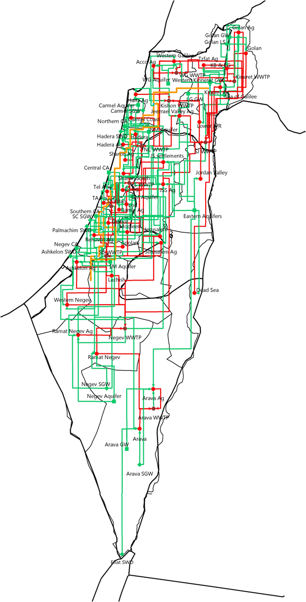
MYWAS – Water-Sector Topology
Freshwater System
Freshwater + Non-freshwater - Agriculture
Wastewater System
November 2022
Notes:
Here we see the topological description of MYWAS which is a dynamic water allocation optimization model. The model details capacities, costs, urban water demand and more. The model provides a high resolution description of the fresh and non-fresh water topology. The model contains data about 16 aquifers and lakes, 3 groups of regional surface reservoirs, 4 brackish-water desalination plants, 5 sea-water desalination plants + 1 optional, 18 agricultural regions, 21 urban/industrial regions, 19 wastewater treatment plants, 183 pipelines for fresh water, 58 pipelines for marginal water.

Slide 7
VALUE – Agricultural Sector, Water Use (2019)
November 2022
Notes:
VALUE is a static model based on the PMP (Positive Mathematical Programing) approach. We calibrate the model so it reproduce the observed agriculture input allocation, and therefore we assume that this allocation is optimal from the farmer position. We calibrate the model so it considers observed and non-observed considerations. The model includes evapotranspiration function as well as agriculture inputs and their price for 55 crops. In addition, it includes demand function for agriculture produce. Its objective is maximizing welfare of farmers and agriculture produce consumers.

Slide 8
Water-Salinity Production Functions
(Shani et al. 2007; Kan, Schwabe & Knapp 2002)
November 2022
Notes:
This is an example of how the VALUE model considers salinity in its production function.

Slide 9
RWRM- Wastewater Treatment Scheme
AS – Activated Sludge
BNR- Biological Nutrient Removal
MBR – Membrane Bioreactor
GF – Granular Filtration
MF – Microfiltration
RO – Reverse Osmosis
Plant Influent
Primary Treatment
Carbon removal - AS
Carbon+ BNR- AS
Carbon removal- MBR
Carbon+ BNR- MBR
GF
GF
MF
MF
MF
MF
RO
RO
RO
RO
RO
RO
Predisposal treatment (P removal)
Brine disposal
Mixed treated wastewater
Disinfection (CL₂)
Notes:
Here we see the RWRM model activity where we have 16 different treatment train which describes 8 treatment technologies. These technologies change the concentrations of 15 different water quality components. Outflow concentrations depends on inflow concentrations and allocation for treatment trains. Each treatment train coupled with cost.

Slide 10
Scenarios
In Practice Standards – The current TWW regulation employed in Israel (“Inbar committee” standards, since 2010)
The “20/30” Regulation – The previous TWW regulation (20mg/l BOD, 30mg/l TSS)
“RO-ONLY” – Hypothetical strictest regulation mandating desalination of all TWW
November 2022
Notes:
In order to examine the influence of quality criteria, we define three scenarios which are based on the situation in TWW market in Israel.

Slide 11
Optimal Solution under In-Practice Regulation
Overtime Development
Wastewater Treatment (m³)
 | Agriculture | Environment | Total
AS | 727 | 9 | 735
BNR | 366 | 8 | 374
MF | 418 | 5 | 423
RO | 35 | 0 | 35
AS-CL₂ | 19 | 0 | 19
AS_BNR-MF-RO | 35 | 0 | 35
AS-MF-CL₂ | 341 | 1 | 342
AS_BNR-CL₂ | 289 | 4 | 293
AS_BNR-MF-CL₂ | 42 | 4 | 46
Total | 727 | 9 | 735
AS – Activated Sludge
BNR- Biological Nutrient Removal
MBR – Membrane Bioreactor
GF – Granular Filtration
MF – Microfiltration
RO – Reverse Osmosis
November 2022
Notes:
Here we see results for optimal solution under Inbar Criteria scenario. We see how TWW is accountable for the growth in agriculture water use which grows by 18% (total of 1250 in the last period). TWW grows by 48% while other agriculture water sources remains the same with a small decrease (-10%) in natural fresh water. Water use at the urban sector rises by 50% over planning horizon. TWW activities reveals that AS and BNR are the most viable technologies, corresponds to reality. However, MF, which rarely in use, found to be preferable technology for meeting Inbar Criteria. In addition, TWW desalination is viable for specific region with high salinity of fresh water (See of Galilee), and not for agronomic reasons.

Slide 12
Optimal Solution under In-Practice Regulation
The most costly polluters are Electrical Conductivity (EC) and Total Suspended Solids (TSS)
Level | 1.33 | 18.08 | 10.00 | 21.55 | 24.97 | 3.09
Constraint | 1.40 | Inf. | 10.00 | Inf. | 25.00 | 5.00
November 2022
Notes:
MF is in wide use to remove TSS, BNR to remove TN and RO to remove EC. Since RO is a very costly treatment, EC produce the highest shadow value.

Slide 13
Water Quantities
Agriculture demand is slightly affected by current criteria but more affected by “RO-ONLY”.
TWW desalination is a substitution to seawater desalination and environmental discharge.
 |  |  | Quantity |  |  |  | Agriculture
 |  |  | (10⁶ m³ year⁻¹) |  |  |  | (10⁶ m³ year⁻¹)
Item |  |  | In Practice | 20/30 | RO-ONLY |  | In Practice | 20/30 | RO-ONLY
Demand
Urban |  |  | 1,257 | 1,272 | 1,222
Agriculture |  |  | 1,150 | 1,156 | 1,108 |  | 1,150 | 1,156 | 1,108
livestock farming |  |  | 121 | 121 | 121
Neighbors |  |  | 140 | 140 | 140
Discharge to "nature" |  |  | 9 | 27 | 0
All |  |  | 2,667 | 2,688 | 2,591
Supply
Fresh Groundw. |  |  | 1,289 | 1,303 | 1,302 |  | 345 | 352 | 268
Brack. Groundw. |  |  | 162 | 166 | 203 |  | 47 | 50 | 69
Brack. Groundw. Desal. |  |  | 88 | 84 | 48 |  | 13 | 16 | 17
Treat. Wastew. To Agri. |  |  | 692 | 717 | 0 |  | 692 | 717 | -
Treat. Wastew. Desal. |  |  | 35 | 0 | 713 |  | 33 | - | 678
Seawater Desal. |  |  | 403 | 418 | 360 |  | 20 | 20 | 72
All |  |  | 2,667 | 2,688 | 2,591 |  | 1,150 | 1,156 | 1,103
November 2022

Slide 14
Welfare Implication
The urban sector bears most of the burden of stricter standards
The overall welfare cost indicates the benefit of improved environment and safety of food and water sources.
Fertilizers embedded in TWW have modest welfare effect.
November 2022

Slide 15
Welfare Implication
TWW marginal value depends on two factors: quantity and quality
The use of TWW contribute to both urban and agriculture
Wastewater Production and Usage (10⁶ m³)
 | Inbar Criteria | 20/30 | RO-ONLY
Total Wastewater | 735 | 745 | 713
Environment | 9 | 27 | 0
Total Agriculture | 725 | 717 | 678
Non-Desalinated TWW | 692 | 717 | 0
Desalinated TWW | 33 | 0 | 678
Brine | 2 | 0 | 36
Wastewater Electrical Conductivity (dS/m)
 |  | Inbar Criteria | 20/30 | RO-ONLY
Wastewater |  | 1.41 | 1.43 | 1.53
TWW to Agriculture |  | 1.33 | 1.42 | 0.09
Environment |  | 1.80 | 1.66 | -
November 2022

Slide 16
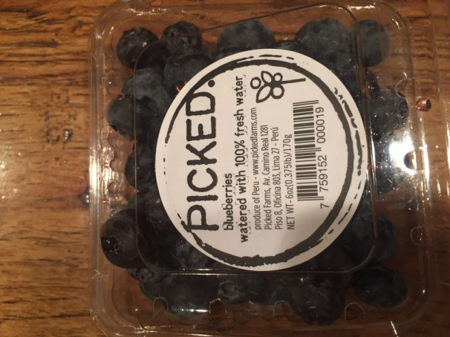
Future analyses
Explicit influence of consumer perception regarding agriculture produce irrigated by TWW
Consequences of TWW-desalination brine disposal
Food production implications
Environmental effects
November 2022

Slide 17
Thank you

