Slide 1
Healthcare Providers’ Knowledge, Attitudes, and Barriers Toward Screening and Treating Food Insecurity
Or Perets-Ohana, B.Sc, R.D. Vered Kaufman-Shriqui Ph.D., M.Sc, R.D. Department of Nutrition Sciences, Ariel University NOV 10, 2022
Notes:
hello everyone my name is Or peres and I’m here on the behalf of Ariel university the nutrition department thank you for inviting me today to talk about health care providers and their attitudes knowledge and barriers towards screening and treating food insecurity

Slide 2
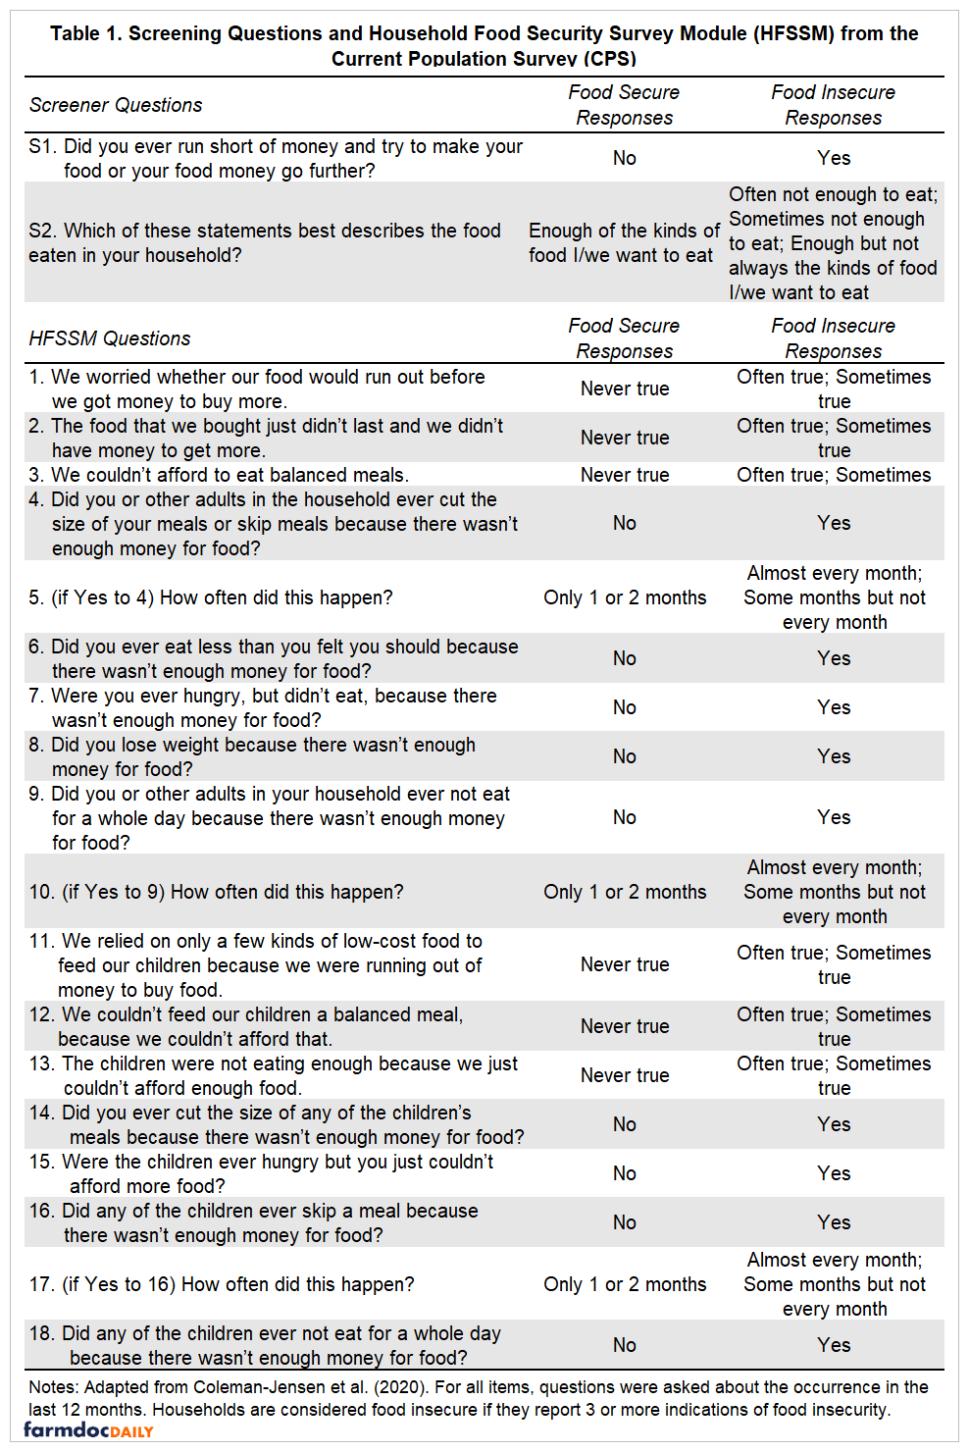
USDA Screening tool for food insecurity
18 items for households with kids under 16 years old
10 items for households with kids over 16 years old
Ellison B, Bruening M. Food Insecurity on College Campuses: FAQs. 2021;.
Notes:
As Rusty showed The most common screening tool we know is the USDA screening tool and it includes 18 items for households with kids under 16 years old and ten items for households with kids over 16 years old.

Slide 3
Food insecurity
Introduction to Food Insecurity in Liverpool: Definitions, Impact, Measurement, and Next Steps 2021. PATTERSON GRACE. (Accessed 09/11/, 2022, at https://www.feedingliverpool.org/introduction-to-food-insecurity-in-liverpool-definitions-impact-measurement-and-next-steps/).
Notes:
As you know after filling out the questionnaire the sum classifieds population into 3 categories mild – worrying about the ability to obtain food
Moderate- comprising quality and variety of food up to reducing quantities or skipping meals.
severe food insecurity stands for experiencing
so basically, we can divide food insecurity into food insecurity with and without hunger

Slide 4
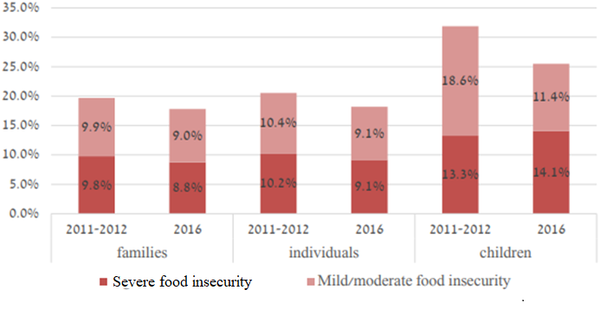
Food insecurity in Israel
Types of food insecurity among families, adult individuals and children, 2011-2012 and 2016
Daniel Gottlieb, Barkali Netanela, heler Oren, Endeweld Miri. Food Security Survey 2016 . National Insurance Institute 2018 Aug.
Notes:
The National Insurance institute in Israel translated the USDA tool into Hebrew and used it in the last national survey for food insecurity in 2016.
The prevalence of FI in Israel in 2016 in families was 17.8%
This survey from 2016 is the last national survey that was made in Israel.
Although in my research I focused on screening for food insecurity within the healthcare, in Israel it’s even more important because there is no regular screening in the national level

Slide 5
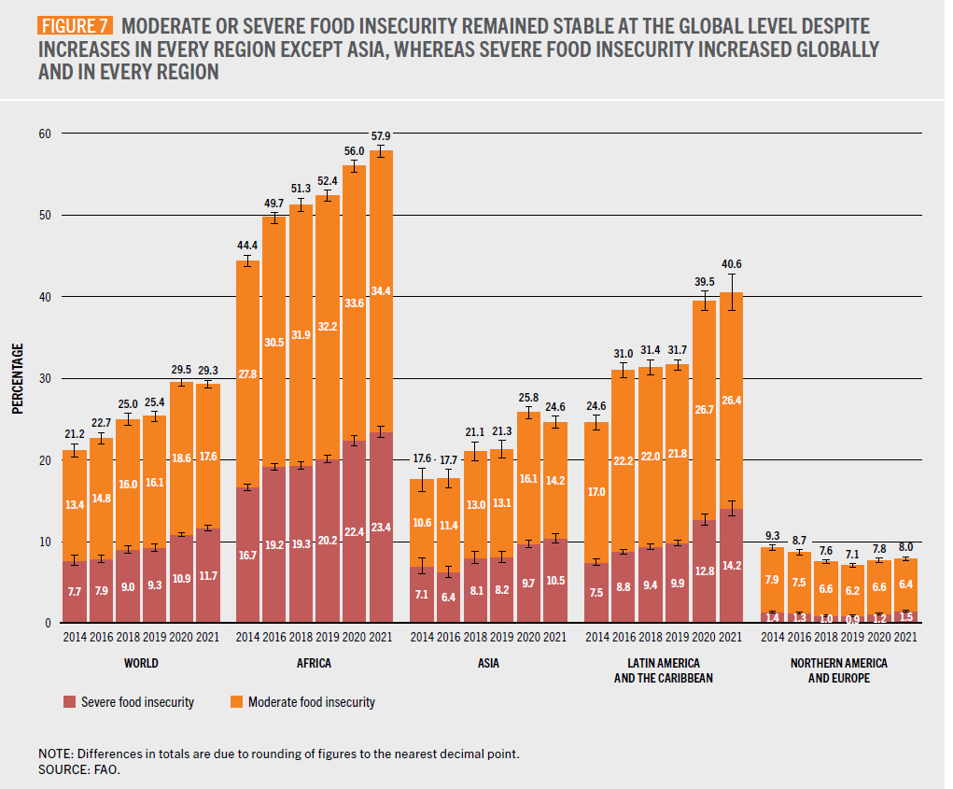
World food insecurity prevalence
Key messages. Available at: https://www.fao.org/3/cc0639en/online/sofi-2022/key-messages.html. Accessed Oct 28, 2022.
Notes:
https://www.fao.org/3/cc0639en/online/sofi-2022/key-messages.html
The global prevalence of FI in the world in 2021 was measured 29.3%, in most of the world the prevalence was rising beside Asia.
There is no doubt that the COVID19 pandemic effects on economy are still can be sensed

Slide 6
Medical organizations that recommend on screening for food insecurity in the healthcare setting
American Association of Retired Persons
American Diabetes Association
American Academy of Pediatrics
Academy of Nutrition and Dietetics
American Family Physician
Feeding America
American hospital association
Notes:
many countries perform national screening for food insecurity I'm not relating to this in my talk today
I will focus on screening for food insecurity in the healthcare setting
recommendations
Here is a list of healthcare organizations how to recommend screening for food insecurity routinely
Lets take a brief look on 2 arrticles from our literature review is

Slide 7
Cross-sectional survey analyses of responses by physician practices and hospitals to the 2017-2018 National Survey of Healthcare Organizations and Systems in USA. Total of 2190 participants.
Notes:
Most healthcare providers do not screen for FI in hospitals and clinics
Here we see research on physicians from 2018 the article aims to find out what is the prevalence of screening for social needs one of them is food insecurity
This article is a cross-sectional……

Slide 8
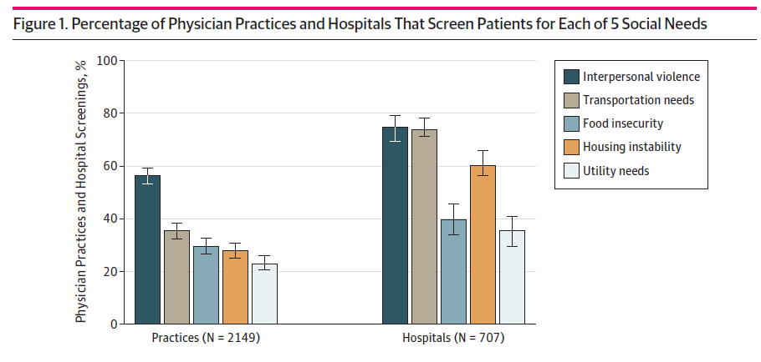
Prevalence of Screening for Food Insecurity, Housing Instability, Utility Needs, Transportation Needs, and Interpersonal Violence by US Physician Practices and Hospitals
29.6% screen for food insecurity in practices
39.8% screen for food insecurity in hospitals
JAMA Netw Open. 2019;2(9):e1911514. doi:10.1001/jamanetworkopen.2019.11514
Notes:
The bright blue represents Food insecurity we can see that only …….
These rates are not negligible but still, the majority of physicians don’t screen for FI

Slide 9
Barriers
JAMA Netw Open. 2019;2(9):e1911514. doi:10.1001/jamanetworkopen.2019.11514
Notes:
האם כדאי להיכנס לשקף הזה? יש בו המון מידע וזו שקופית שקצת יותר מורכב להציג... האם פשוט להציג בלי הטבלה את עיקרי הדברים?
These are barriers described by physicians in this article,
We see here the results for practices and hospitals
And the barriers for physicians who screen for social needs divide to physicians who screen and do not screen/ we can see
That lack of financial resources is a barrier for more than 75% of physicians in hospitals and practices of them approximately 37% describe it as a major barrier
Among workers who don’t screen lack of financial resources is described as a barrier with a higher percentage more than 85% in practices and hospitals
Lack of time is another barrier identified by a majority of physicians as a barrier. In practice, 75% of physicians who screen for FI describe it as a barrier but only 28.5 see it as a major barrier. The same trend is seen in hospitals 66% of physicians who screen describe it as a barrier but only 18.1% of them describe it as a major barrier
An additional 2 barriers to pay attention to are lack of knowledge and lack of process for disseminating, which are described as a minor barrier in all sections also at hospitals and

Slide 10
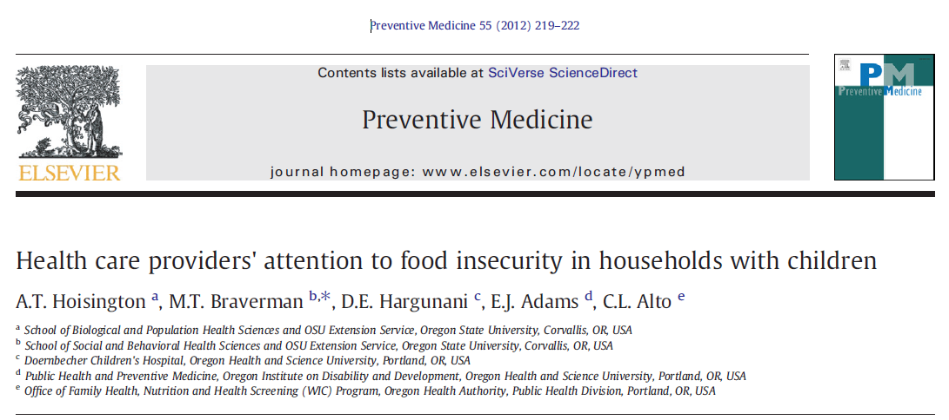
Cross-sectional study, a mail survey of family practice and pediatric physicians and nurse practitioners in Portland, Oregon. 186 responses.
Notes:
Another research I would like to present

Slide 11
Main outcomes
Most respondents did not routinely inquire about household food insecurity during clinic visits.
88.8% expressed willingness to use a standardized screening tool, if available.
Hoisington AT, Braverman MT, Hargunani DE, Adams EJ, Alto CL. Health care providers' attention to food insecurity in households with children. Prev Med. 2012;55(3):219-222. doi:10.1016/j.ypmed.2012.06.007
Notes:
We see that in this research the prevalence of screening is lower.
Next we will see that in Israel we are more close to this rates of screening.

Slide 12
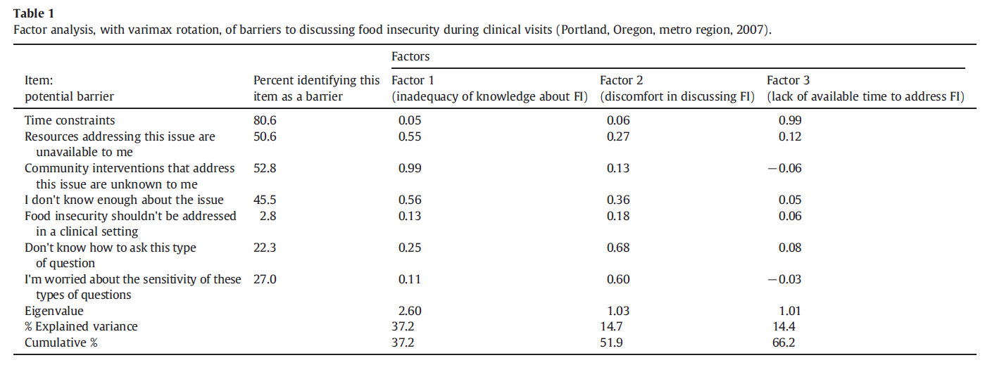
Barriers
Hoisington AT, Braverman MT, Hargunani DE, Adams EJ, Alto CL. Health care providers' attention to food insecurity in households with children. Prev Med. 2012;55(3):219-222. doi:10.1016/j.ypmed.2012.06.007
Notes:
Here we see the barriers let’s take a better look at the barriers and not on the factors analysis

Slide 13
Barriers
Hoisington AT, Braverman MT, Hargunani DE, Adams EJ, Alto CL. Health care providers' attention to food insecurity in households with children. Prev Med. 2012;55(3):219-222. doi:10.1016/j.ypmed.2012.06.007
Notes:
Here we see the barriers let’s take a better look at them
Time – asking 18 questions takes alt of time

Slide 14
What is known about the attitudes and practices of healthcare providers in Israel toward screening for food insecurity?
Notes:
All above led us to the question

Slide 15
Study Aims
To describe the knowledge and attitudes of healthcare providers toward screening food insecurity
To identify the main barriers of healthcare providers toward screening food insecurity
Notes:
Our study aims were…

Slide 16
Qualitative exploratory Research- Methods
Semi-structured interviews
Convenience sample of 15 health professionals: nurses, hemodialysis nurses, dietitians, physicians, and pharmacists
Interviews were transcribed, and central themes were identified
Notes:
Our overall research is wider and included quantitative parts and here I will present only our exploratory qualitative research
we performed a qualitative pilot study among health professionals. Interviews with different health professions nurses, hemodialysis nurses, dietitians, physicians, and pharmacists the total of 15 interviews
Using convince sample and semi-structured interviews.
Now I’ll represent to you quotes from our interviews

Slide 17
Hemodialysis nurses
“Some of the patients don’t eat the served food in the hemodialysis unit and they take the food to their houses to eat the food there.”
“There are patients who ask to receive food leftovers at the end of the day…”
Notes:
Hemodialysis Nurses said…..

Slide 18
Nurses
Nurse in pediatric diabetes clinic: “Sometimes I don't have time to sit with them.....We are putting the puzzle together and maybe in the end they will open up and people won't be ashamed. I sometimes see them, they come back to us with requests for food. Shame is a difficult emotion”
Nurse in medical clinic: “The clothes are very hanging on them and you can see that these are clothes that were previously bought when they were at a higher weight. I do a lot of home visits and you can see that they have nothing to offer you and they don't really have anything to eat."
Notes:
The clothes are very hanging on them and you can see that these are clothes that were previously bought when they were at a higher weight. I do a lot of home visits and you can see that they have nothing to offer you and they don't really have anything to eat."
“... What's important is even before the contact with the families is to keep the premature babies alive and that's why we don't have enough time and we work in a crazy rush and only manage to do what really has to happen”
you can see that these are clothes that were previously bought when they were at a higher weight.

Slide 19
Dietitians
"I don't have an official, valid tool that I use, so it's more of a general impression”
" Patients receive cheaper medical treatment than treatment that would have been more beneficial to them and then I can try to understand what the nutritional food basket they buy and understand whether it is because they cannot buy or for some other reason”
"You need to know how to identify them sensitively”

Slide 20
Pharmacists
“A patient who is debating whether to purchase medication, so I estimate that he will be in nutritional insecurity”
“I'm not exactly looking at the matter of the nutritional issue, but more of a medical one”

Slide 21
Physicians
“Time.....and what to do with it later? We can do it and then refer it to whoever needs it, but we don't have time to deal with it”
“Not all my patients, but by familiarity. Two working parents or number of children or
worn out clothing or teeth”
Notes:
First question is about barriers
The second quote is the answer to the question “o you think it is correct to find out about this topic with all your patients? If not - according to what criteria would you choose who to inquire with?”
I think the quotions speak for them self

Slide 22
Main outcomes
None of the healthcare providers reported screening for food insecurity
Healthcare providers reported a lack of knowledge and no familiarity with food insecurity screening tools
Most of the healthcare providers reported that they don’t have enough knowledge of how to treat or where to refer patients with food insecurity.
Notes:
לא מכירים ולא משתמשים

Slide 23
Main Barriers
Time constraints
Lack of knowledge
Embarrassment in questioning for FI
Uncertainty us to “whose role is it to screen”?
Notes:
In comprising to what we saw in the literature
time and lack of knowledge are similar to the barriers that we find in the literature
In our study Two findings are unique – the embarrassment of screening and the uncertainty us to
A main theme unce….
בדומה למחקר האמריקאי המצייג שראינו את
חן ומורן – דיאליזה
בשאלונים של האחיות בדיאליזה דירגו את הנושא של חוסר נעימות בשאלת שאלות כאלו בממוצע של 3.6 מתוך 5
מחסום זמן דורג 3 מתוך 5
תחושת נוחות בשאית השאלות – 3 הרגישו בנוח לשאול מציינים כי זה קשר ארוך טווח ואחרי זמן מה אין קושי לשאול את השאלות הללו
מכירים זמן רב
בר וליטל רוקחים – מובן מהשיח כי רוקחת אחת לא כ"כ חושבת שהסיקור נופל באחריותה – 2 רוקחות אחרות מוכנות לסקר
חוסר ידע בנוגע לנושא עלה במהלך הראיון – לא נשאלו ישירות על מחסומים
רופאים: מחסומים שצויינו 2 – זמן 1 – הבושה של המטופלים
2 ציינו מה עושים עם סיקור חיובי?
כולם לא הרגישו בנוח עם שאילת שאלות מהסוג הזה
דיאטניות –סתיות
- תפנה לרווחה – נראה כי היא מרגישה בנוח לשוחח איתה על אי ביטחון תזונתי
לא נשאלו על מחסומים
- תפקיד הסיקור – זה לא התפקיד של הדיאטנית.
שתי דיאטניות אומרות שזה לא התפקיד שלהן.
דיאטנית שנייה לא התבטאה בנוגע לנוחות בשאילת השאלות
דיאטנית אחת ציינה כי חשוב לא רק לקבל הדרכה איך לסקר אל גם איך לעזור
אחיות מור וליאור:
תפקיד של מי – אחות אחת לא כ"כ יודעת אם זה מתאים להן אחות אחרת אומרת שחסר להם ידע על מנת לסקר
יותר נוח לשוחח על הנושאים האלה מול העו"ס.
מחסומים – ידע וזמן (בעיקר זמן)

Slide 24
Discussion
Healthcare providers in Israel may see symptoms of socioeconomic problems among their patients however, there is uncertainty as to whose role is it to screen for FI.
Main barriers include lack of knowledge, time, discomfort, and system barriers in further referral.
Notes:
In Israel we have no national nutrition supporting programs such as meals on wheels or SNAPS its more non-profit organizations
We need to help the health system build educational programs on food insecurity
Easy to cope with
are

Slide 25
Recommendations
Policy discussions should be held within the healthcare system.
Education and capacity building is needed among healthcare providers.
Evaluation research is needed to further document practices and attitudes.

Slide 26
Study limitations
Small sample size
Convenience sample
Non-representative of the healthcare providers in Israel
Notes:
However, themes reach saturation despite the small sample size

Slide 27
Thank you

