Slide 1
Promoting Resilience in Combatting Food Insecurity using the Sociotype Framework
Elliot M Berry MD, FRCP
Dept. of Human Nutrition and Metabolism
Braun School of Public Health,
Hebrew University – Hadassah Medical School
Jerusalem, Israel
November, 2022

Slide 2
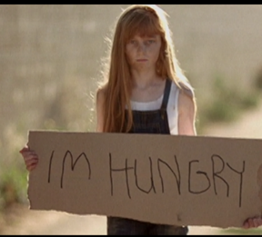
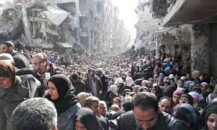
Promoting Resilience in Combatting Food Insecurity using the
Sociotype Framework
What is the Sociotype?
Food InSecurity Challenges in Times of COVID & Conflict?
Short-term & Long Term Coping

Slide 3

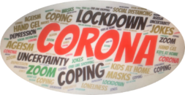
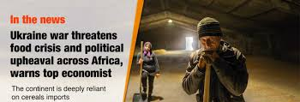




COVID
CONFLICT
CLIMATE CHANGE
CYBER WARFARE
COSTS
COMPLEXITY
CHAOS
FOOD
ENERGY
WATER
COMMODOTIES
HUMANITARIAN
COPING with
MAJOR
C R I S E S

Slide 4
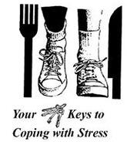
C O P I N G
Nutrition
& Fitness
Q: How do we COPE with “LIFE” stresses in general, and chronic disease and Food Insecurity, in particular?
A: Well, it all depends on your SOCIOTYPE……
Organizational Ecological Framework
Multi-Disciplines: Anthropology, Medicine, Nursing,
Physiology, Psychology, Sociology, & more…
Berry EM. The role of the sociotype in managing chronic disease: Integrating bio-psycho-sociology with systems biology. Medical Hypotheses 77 : 610, 2011
Berry EM & DeGeest S. Tell me what you eat and I will tell you your sociotype: coping with diabesity. RMMJ 3:e0010, 2012.

Slide 5
Sociotype x Genotype determines Phenotype
No one NORMAL Sociotype – Everyone has his/her own Sociotype…
EPIGENETICS
Sociotype
Genotype
Constantly
Changing
Inputs
PHENOTYPE
Observable
Characteristics
Behavior Patterns
Personality
e.g. COPING
Relatively
Unchanging
Input
Why you are, how you are &
Why you do, what you do…
Sociotype changes within an individual during life time
Individual
Relationships
Context
in utero ➔ Childhood ➔ Adolescence ➔ Adult ➔ Middle Age ➔ Old Age
E X P E R I E N C E
Berry et al. Health Psychol & Behav Med. 5 : 177, 2017

Slide 6

Factors Affecting the Sociotype Domains
Individual Health
Growth & Development
Upbringing
Physical, mental well-being
IQ, EQ
Chronic disease
Spiritual belief systems
Sense of humor
Coping strategies
Relationships
Family
Friends – social networks
Partners, lovers
Work relationships
Professional advisors
Carers
Strangers
Coping strategies
Context
Demographics
Education
Economic situation - employment
Environment – home, leisure, work
Religious system
Culture, societal values
Political system
Health system
Legal system
Food system
Coping strategies

Slide 7
Coping & Mastery Skills are lower in less educated, the poor & the sick
C O P I N G & M A S T E R Y N= 1296
No relation to Age
-ve Smoking, Stress,
Living Alone
+ve Health Behaviors, Education,
Economic Situation
Coping & Mastery
Years of Education
Relative Economic Situation
Health Status
Berry et al, 2017

Slide 8
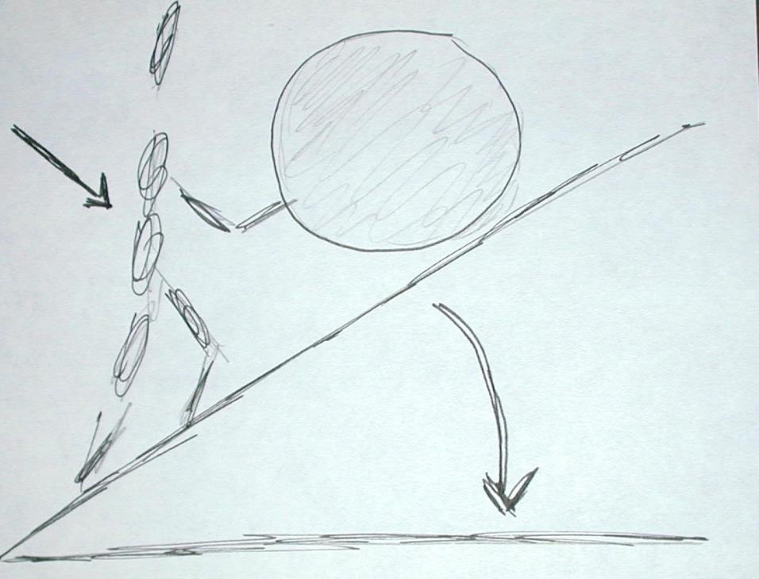


NUTRITION
= FUEL
Highest Octane
Individual Behaviour
<Individual Health>
C O P I N G
with
LIFE TASKS
Sociotype
“ BAGGAGE”
Experiences,
Expectations
Load/Unload
Change in
<Relationships>
<Context>
Consider also:
Juggling the # & type of those balls…..
Soles of your shoes….
P Puska napkin, Restaurant Geneva 2001

Slide 9


Nutritional & Sociotypic Influences through the life cycle in Health & Disease
Old Age
(Pre-)
Pregnancy
Caloric
Restriction
Programming
Fetal Origins
Epigenesis
Nutrition
Maturity
Childhood
Diet x Gene
“Stress”
CVD
Cancer
DIABESITY
Breast Feeding
Bonding
Microbiome
Fertility
Mate selection
Adolescence
Physical/ Mental
Potential
Eating Disorders
Food & Mood
Cultural norms
Body image

Slide 10

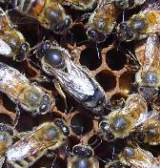
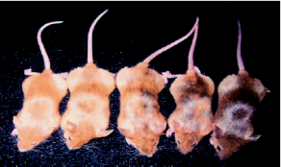

Influences of Sociotype on Phenotypic Development – Biological Mechanisms
Bees feeding different food to produce workers or Queens – royalactin royal jelly
Epigenesis in agouti
Metabolic Programming in utero effects on 2nd generation disease – “Pup-in-a-cup”
Licking & Grooming & glucocorticoid receptor DNA methylation / acetylation
Oxytocin / Vasopressin (levels during COVID ?)
Allostasis – Stress, Autonomic & Cortisol responses
Famine studies, Fetal origins hypothesis
Metabolic syndrome / Schizophrenia
Typical Sociotypic Example:
Dogs brought up with cats…
Methylation➔

Slide 11
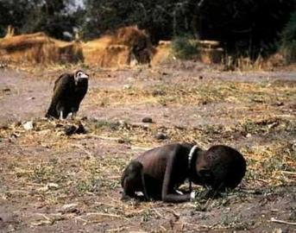
Outline
Sudan famine in 1994.
The child is crawling to a UN food camp.
The vulture is waiting for him to die
No one knows what happened to the child.
Photographer, Kevin Carter committed suicide 3 months later
Food Security is a Fundamental Human
Right
What is the Sociotype?
Food InSecurity Challenges in Times of COVID & Conflict?
Short-term & Long Term Coping

Slide 12
Food Security Pathway and Sociotype Domains
Agricultural
Aquaculture
Production
Imports
Level
Availability
National - Context
Loss
Physical
Economic
Accessibility
Household - Relationships
Waste
Quality / Safety
Quantity
Health
Utilization
Individual
FOOD SECURE
Stability
Vulnerability
“Short term”
SUSTAINABILITY
Environment, Economic, Culture
GENERATIONS
“Long Term”
after Berry et al, 2015

Slide 13
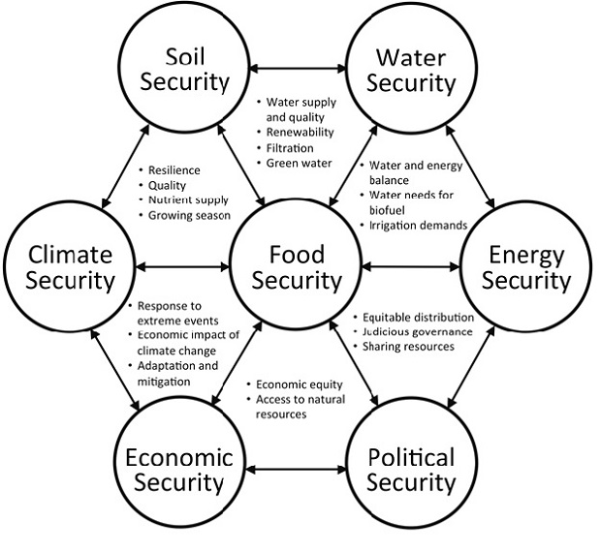
Sustainability “Securities” ensure Food Security: Systemic Approach
Soil Security
Water Security
“Food Insecurity exists whenever the availability of nutritionally adequate and safe foods, or the ability to acquire acceptable foods in socially acceptable ways, is limited or uncertain” J Nutr 120: 1559
Climate Security
Food Security
Energy Security
Linked to:
Eating less Fruit & Vegs
Increased risk of NCDs
Poor Mental Health
Behavioral, Emotional and Academic Barriers in Children
Social Exclusion
Increased Health Costs
Economic Security
Political Security

Slide 14
Food Security Systems are connected to other Systems – as a Complex Adaptive System
FOOD SECURITY
Sustain-ability
Environ-ment
Geo-Politics
Policy
Health & Nutrition
Socio-Cult-Econ
Ecology & Climate Systems
Economic & Governance Systems
Health
Systems
Science & Innovation Systems
after Scientific Group for the UN Food Systems Summit, 2021

Slide 15


Vicious cycles of Food Insecurity
Malnutrition ↔ Infection Cycle
Covid
Poor Eating Habits
Physical Inactivity
Obesity
?food waste?
Isolation,
Taste↓
Access:
Physical
Economic
Physical, Mental
ill Health
Unrealized Potential
Financial Hardship
Amount
Variety
Balance
Malnutrition
Quantity
Quality
Safety
Food Insecurity
Hidden Hunger

Slide 16
Food Insecurity (%( in Israel varies greatly by sector - 2016 to 2021
By Family
Single Mother 32%
Single Father 23%
Both-Parents 16%
42.4%
By Change in Employment
During COVID Pandemic
Salary Cut 30%
Decrease work hours
Lay-off 26%
Unpaid leave
No Change 10%
17.5%
21.1%
16.2%
10.7%
15.8%
11.9%
Poverty (2020) 21% 28.7% 13.5%
Food Insecurity Prevalence: World 2019 ~26%; Japan ~16%;
Canada, US, UK, Fr 9-11%; IL 11-42%!! (OECD, 2021)
Social Policy Institute, 11. 2021
Bituach Leumi, 2021

Slide 17
National Insurance
Food Insecurity –
Whose Responsibility?
Ministries:
Agriculture;
Environment Protection; Social Equality;
Science & Technology; Economy & Industry;
Biannual Surveys Food Security
Central Bureau Statistics
Education
Health
Interior
Finance
Welfare
Food Security Forum
Food Security Council
Monitoring & Evaluation???
Local Authorities (257)
School Feeding Programs
NGOs
NGOs
Defense
National Emergency Council
Food Aid Distribution
Home Front

Slide 18

















Who “Conducts the Food Security Orchestra”???
Ministries of Welfare: Education
Ministries of Agriculture: Finance
Ministries of Economics: Law
Ministries of Interior: Social Equality: Senior Citizens: Defense, Home Front
National Emergency Committee
National Security Council
Local Authorities
National Insurance Organization
Four Health Maintenance Organizations
Authority for Food Security
Israel Volunteers Association
NGOs
Joint Welfare Organization
……….
הרשת הישראלית להתנדבות:
'לקט ישראל': לתת ועוד NGOs
ג'וינט:
פורום הגיל השלישי לקורונה
ועוד...

Slide 19
FOUR Questions & Challenges for Food Insecurity
How to assess food insecurity? by Qs, (how many?) by income? Data Collection, Dashboards
Who should get aid? Criteria?: Food Fortification (for All) vs Food Supplementation (for At Risk).
  Economically disadvantaged - School Feeding Programs
  Countering STIGMA
  “Help HOT Line”
What aid to be delivered? Food or Money or equivalent - Food stamps? - Subsidies for healthy food. Role of NGOs, Food Banks
How to Plan?
  Short term: – emergencies COVID, CONFLICT
  Long-term: Food Stores, Supply Chains, Sustainability

Slide 20
Promoting Resilience in Combatting Food Insecurity using the
Sociotype Framework
What is the Sociotype?
Food InSecurity Challenges in Times of COVID & Conflict?
Short-term & Long Term Coping

Slide 21












Increasing Resilience to Food Insecurity using the Sociotype Framework
Leveraging Crises ➔ Opportunities ➔ Change Points
Individual
  Health and wellbeing – Individual and Parental responsibilities
  Women’s empowerment
  Relationships (Household, Community, Living Environment)
  Family Budgeting – Informed Food choices, Zero waste
  Seasonality, Farmers markets, Plant-based foods, Poultry, Fish
  Sharing Food, Traditional knowledge – urban ⬅➔ rural
  Socialization, Agency (Civil Society) dialogues – 4 benefits of Mediterranean Diet
Context (Institutions, Policy)
  National Emergency Plans for Food, Water, Energy Security (short and long-term)
  Education: School & Community - Positive Nutrition and Lifestyle messages
  Social Inequalities – inclusivity, Food Aid
  Regulation of Food Industry and Catering sectors
  Best Sustainable Agricultural practices, Agro-Tec, Food-Tec
  International Trade, Co-operation & Research towards Sustainable Food Systems
“Out of the strong came forth sweetness….”

Slide 22








For the next Pandemic / Crisis: Actions @ Context Domain
Short Term
Long Term
National committee for emergency disasters: risk management, response and monitoring
Strengthen health infrastructure, BEDS, ICUs; disease surveillance, manpower, research, emergency supplies & equipment (PPE)
Global network for alerts, & collaboration, Control of Animal Markets
Help developing countries with security for regular access to Food, Energy & Water
Empower Civil Society; Counter social media for fake news & misinformation – anti-Vaxxers
Medical aid & vaccinations to countries with weak public health infrastructures
Social and food support for at risk groups – homeless, elderly, lonely & more. SCHOOL MEALS
Economic recovery at national and international levels
Peng & Berry, 2021

Slide 23

Combating Food Insecurity in Israel: Lessons from COVID
Conclusions
Food Security as a basic Government Responsibility (= health, education, defense); access for ALL to Affordable, Healthy Food – MeDiet
Preparedness: Multi-disciplinary teams with defined leadership and dedicated budgets for next pandemic / crisis
Long-term SYSTEMIC Policies towards Sustainable Food Systems
Promoting Resilience through the Sociotype Framework –
Individual, Relationships, Context Levels
“Death and Life lie in the power of the tongue” (Proverbs 18:21)
“You cannot compare a person with bread in his basket to one who has none” (BT Yoma 74b)

Slide 24


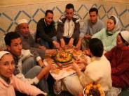

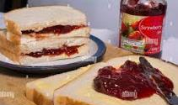
“Tell me what YOU eat &
I will tell you who YOU are”
“Tell me how a FAMILY eats & I will
tell you how it FUNCTIONS”
“Tell me how a NATION eats &
I will tell you its VALUES”
Individual
S
O
C
I
O
T
Y
P
E
▼
▼
Relationships
Context
Do kids go to bed hungry??
Do kids go to school without breakfast??
Do the elderly live off bread, margarine and jam?
= COPING with FOOD INSECURITY &
SOCIAL JUSTICE, EQUITY & SUSTAINABILITY

